Slide 1
Child Abuse Prevention & Response Resources

Slide 14
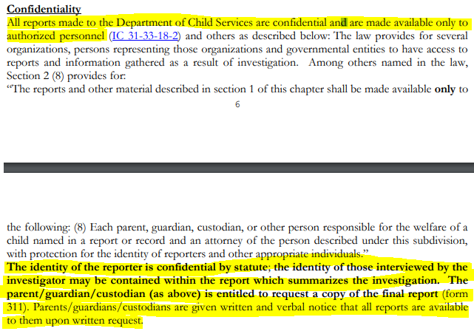

Slide 19
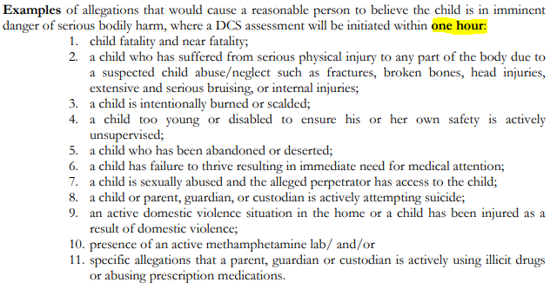

Slide 22
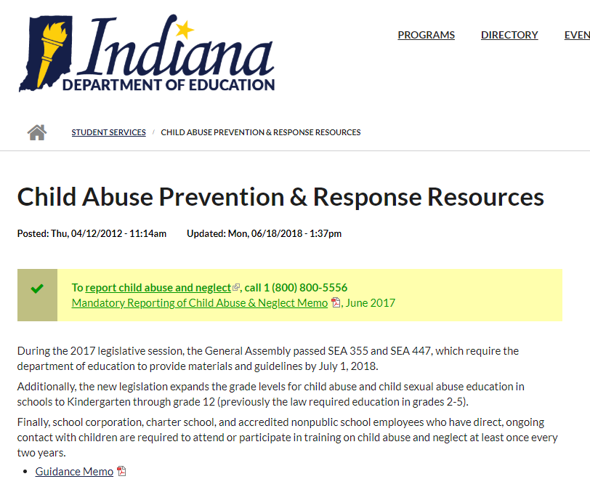

Slide 23
