Slide 1
Indiana Department of Education Youth Gang Awareness

Slide 2
Why Do Youths Join Gangs
Social Discrimination & Rejection
Absence of a Family & its Unconditional Love
Lack of Positive Role Models
Lack of Proper Discipline
Lack of Positive Free-Time Activities
Fear, Abuse, Lack of Security
Economic Deprivation
School Failure and Delinquency
Low Self-Esteem
Pathological Offenders’ Needs
Influence of Migrating Gang Member
Mike Carlie, Ph.D., 2002, Into The Abyss: A Personal Journey into the World of Street Gangs

Slide 3
Indiana Seeing sharp Rise in Youth Violence
Indiana Youth Institute Statistics as presented in the 2015 Indiana Kids Count Profile of Child Wellbeing
Dramatic increase in homicides among children and teenagers.
Gang membership may be one cause, it’s up 11 percent among teens with many kids being recruited at age 14.
Teenagers committing murder is rising.
Nearly a fifth of high school students regularly carry a weapon.
Homicide as cause of death in youth 15-24 years of age:
#1 among Blacks
#4 among whites and Hispanics
.
Notes:
It’s becoming increasingly dangerous to be a child in Indiana.
Statistics released by the Indiana Youth Institute show Indiana saw a sharp increase in homicides among children and teenagers.
The institute's interim CEO and president, Glenn Augustine, called the statistics alarming.
Teenagers committing murder rose in 2012 and 2013, after two years of declining. Gang membership may be one cause, it’s up 11 percent among teens with many kids being recruited at age 14. Nearly a fifth of high school students regularly carry a weapon.
The statistic show homicide was the top cause of death among blacks ages 15 to 24, with 105 deaths. Accidents were the second leading cause with 32, followed by suicide with 10 and fourth was death by a law enforcement officer, with four. Among both whites and Hispanics, accidents were the leading cause of death, followed by suicide and homicide.
The annual Kids Count shows one in 10 parents say their kids are growing up in unsafe neighborhoods, with rates much higher among Hispanic and black parents. That means less time for kids to play outside, and dangerous walks to school.

Slide 4
Indiana Seeing sharp Rise in Youth Violence
Indiana Youth Institute Statistics as presented in the 2015 Indiana Kids Count Profile of Child Wellbeing
Firearms were used in three quarters of homicides by youth under age 18 in Indiana (76% between 2008 and 2013), followed by knives, personal (hands, fists, feet) and blunt objects.*
7 in 10 kids have witnessed violence.
29 percent of Indiana high school students were involved in a physical fight at least once in the past year.
Youth who have had contact with the Indiana juvenile justice system have higher mortality rates than the general population, regardless of sex or race
U.S. Department of Justice Office of Juvenile Justice and Delinquency Prevention. (2013). Easy Access to the FBI’s Supplementary Homicide Reports (EZASHR)
.
Notes:
U.S. Department of Justice Office of Juvenile Justice and Delinquency Prevention. (2013). Easy Access to the FBI’s Supplementary Homicide Reports (EZASHR)
Firearms were used in three quarters of homicides by youth under age 18 in Indiana (76% between 2008 and 2013), followed by knives, personal (hands, fists, feet) and blunt objects.*
Indiana Youth Institute Statistics as presented in the 2015 Indiana Kids Count Profile of Child Wellbeing
7 in 10 kids have witnessed violence.
29 percent of Indiana high school students were involved in a physical fight at least once in the past year.
Youth who have had contact with the Indiana juvenile justice system have higher mortality rates than the general population, regardless of sex or race

Slide 5
How Gangs Affect A School
46 percent of students in public schools reported the presence of gangs and gang members at school⁺
Most youth gang activity occurs at school*
More violence at school
More guns at school
Increase of drugs on campus
Class disruptions, taking learning time away while teachers have to deal with behavior issues
Lower attendance
Higher dropout rate
Increased workload on teachers, school resource officers, other school staff, law enforcement, judicial system
+NCASA at Columbia University, 2010, *National Center on Addiction and Substance Abuse at Columbia University
Notes:
How Gangs Affect A School
More violence at school
More guns at school
Increase of drugs on campus
Class disruptions, taking learning time away while teachers have to deal with behavior issues
Lower attendance
Higher dropout rate
Increased workload on teachers, school resource officers, other school staff, law enforcement, judicial system

Slide 6
School Risk Factors Associated with Gang Involvement
Poor school performance
Low educational aspirations
Negative labelling by teachers
High levels of anti-social behavior
Few teacher role models
Educational frustration
Low attachment to school
Learning difficulties
Low involvement in extracurricular activities
Howell, James C. "Moving Risk Factors into Developmental Theories of Gang Membership," Youth Violence and Juvenile Justice, 3, 4, (2005) pp. 334-354.
Notes:
School Risk Factors Associated with Gang Involvement
Poor school performance
Low educational aspirations
Negative labelling by teachers
High levels of anti-social behavior
Few teacher role models
Educational frustration
Low attachment to school
Learning difficulties
Low involvement in extracurricular activities

Slide 7
Examples of gang-related behavior in schools may include, but are not limited to:
The use of certain hand signals or gestures that may, in any way, be linked to a gang or gang-related activity or behavior.
Graffiti that may, in any way, be linked to a gang or gang-related activity or behavior.
Identifying oneself as a member of a gang.
Recruiting or soliciting membership in a gang or gang-related organization.
Atlanta Public Schools, 2014, Grove Park Elementary School
Notes:
Examples of gang-related behavior in schools may include, but are not limited to:
The use of certain hand signals or gestures that may, in any way, be linked to a gang or gang-related activity or behavior.
Graffiti that may, in any way, be linked to a gang or gang-related activity or behavior.
Identifying oneself as a member of a gang.
Recruiting or soliciting membership in a gang or gang-related organization.

Slide 8
Examples of gang-related behavior in schools may include, but are not limited to:
Presence of any apparel, jewelry, accessory or manner of grooming which, by virtue of its color, arrangement, trademark, symbol, or any other attribute indicates or implies gang membership or affiliation with such a group.
Initiation, hazing, intimidation, and/or related activities of such group affiliations that are likely to cause bodily danger, physical harm, or personal degradation or disgrace resulting in physical or mental harm to students or staff.
Notes:
Examples of gang-related behavior in schools may include, but are not limited to:
Presence of any apparel, jewelry, accessory or manner of grooming which, by virtue of its color, arrangement, trademark, symbol, or any other attribute indicates or implies gang membership or affiliation with such a group.
Initiation, hazing, intimidation, and/or related activities of such group affiliations that are likely to cause bodily danger, physical harm, or personal degradation or disgrace resulting in physical or mental harm to students or staff.

Slide 9
Examples of gang-related behavior in schools may include, but are not limited to:
Threatening to commit, or actually committing, any crime with the purpose of terrorizing another, causing the evacuation of a school system facility or school bus, causing disruption to the orderly operation at any school system facility
Using, employing, or relying upon gang membership or affiliation to threaten, intimidate, or to harass students and/or staff.
Notes:
Examples of gang-related behavior in schools may include, but are not limited to:
Threatening to commit, or actually committing, any crime with the purpose of terrorizing another, causing the evacuation of a school system facility or school bus, causing disruption to the orderly operation at any school system facility, or acting in reckless disregard of the risk of causing such terror or disruption.
Using, employing, or relying upon gang membership or affiliation to threaten, intimidate, or to harass students and/or staff.

Slide 10
Behavioral CHANGES that may indicate gang involvement
Withdrawing from family activities and planned events.
Changed academic performance or declining school attendance.
Defiant or confrontational behavior, such as talking back, verbal abuse, name-calling, and disrespect for teacher/parental authority.
Staying out late without reason.
Angry outbursts, excessive aggression.
Excessive worry about safety; constantly surveying surroundings for danger.
Sudden negative attitudes about law enforcement or adults in positions of authority (school officials or teachers).
2015 Parents’ Guide to Gangs, National Gang Center, Office of Juvenile Justice and Delinquency Prevention, USDOJ
Notes:
NOTE: These behavioral signs do not necessarily confirm a child is a gang member. These are merely the most common signs of gang involvement.
Behavioral CHANGES that may indicate gang involvement
Withdrawing from family activities and planned events.
Changed academic performance or declining school attendance.
Defiant or confrontational behavior, such as talking back, verbal abuse, name-calling, and disrespect for teacher/parental authority.
Staying out late without reason.
Angry outbursts, excessive aggression.
Excessive worry about safety; constantly surveying surroundings for danger.
Sudden negative attitudes about law enforcement or adults in positions of authority (school officials or teachers).

Slide 11
Behavioral CHANGES that may indicate gang involvement
Change in attitude about school, church, or other normal activities or change in behavior when attending these activities.
Drastic changes in personal style.
Withdrawal from longtime friends and forming bonds with an entirely new group of friends.
Suspected use of drugs, such as alcohol, inhalants, and narcotics.
Possession of firearms, ammunition, or other weapons.
Non-accidental physical injuries (such as evidence of being beaten or injuries to hands and knuckles from fighting).
Unexplained cash or goods, such as clothing, video games, or jewelry.
Parents’ Guide to Gangs, 2015, National Gang Center, Office of Juvenile Justice and Delinquency Prevention, USDOJ
Notes:
NOTE: These signs do not necessarily confirm a child is a gang member. These are merely the most common signs of gang involvement.
Behavioral CHANGES that may indicate gang involvement
Change in attitude about school, church, or other normal activities or change in behavior when attending these activities.
Drastic changes in personal style.
Withdrawal from longtime friends and forming bonds with an entirely new group of friends.
Suspected use of drugs, such as alcohol, inhalants, and narcotics.
Possession of firearms, ammunition, or other weapons.
Non-accidental physical injuries (such as evidence of being beaten or injuries to hands and knuckles from fighting).
Unexplained cash or goods, such as clothing, video games, or jewelry.

Slide 12
Individual risk Factors for youth violence
Past violent victimization
Early aggressive behavior
Poor behavioral control/hyperactivity
Antisocial behavior
Lack of guilt or empathy
Drug or alcohol abuse
Exposure to family conflict and violence
Exposure to violence in media
Having been a victim of bullying
Difficulty controlling feelings, especially anger
Major mental illness
Parental substance abuse or history of crime
Centers for Disease Control and Prevention; Office of Juvenile Justice and Delinquency Prevention
Notes:
Individual risk Factors for youth violence
Past violent victimization
Early aggressive behavior
Poor behavioral control/hyperactivity
Antisocial behavior
Lack of guilt or empathy
Drug or alcohol abuse
Exposure to family conflict and violence
Exposure to violence in media
Having been a victim of bullying
Difficulty controlling feelings, especially anger
Major mental illness
Parental substance abuse or history of crime

Slide 13
Family risk Factors for youth violence
Low parental involvement
Low emotional attachment to parents
Inconsistent disciplinary practices
Poor parental supervision and monitoring
Large family size
Presence of firearms in the home
Centers for Disease Control and Prevention; Office of Juvenile Justice and Delinquency Prevention
Notes:
Family risk Factors for youth violence
Low parental involvement
Low emotional attachment to parents
Inconsistent disciplinary practices
Poor parental supervision and monitoring
Large family size
Presence of firearms in the home

Slide 14
community risk Factors for youth violence
Association with delinquent peers
Peer rejection
Low school commitment/involvement
High-crime neighborhoods
Socially disorganized neighborhoods
High concentration of lower socioeconomic groups
Gangs and easy access to firearms
Centers for Disease Control and Prevention; Office of Juvenile Justice and Delinquency Prevention
Notes:
Community risk Factors for youth violence
Association with delinquent peers
Peer rejection
Low school commitment/involvement
High-crime neighborhoods
Socially disorganized neighborhoods
High concentration of poor residents
Gangs and easy access to firearms

Slide 15
Basic Observable Gang Identifiers
Social Media Content/Cellphone Communication
Symbols, Numbers, Colors, Drawings
Graffiti
Hand Signs
Notes:
Basic Observable Gang Identifiers
Social Media Content/Cellphone Communication
Symbols, Numbers, Colors, Drawings
Graffiti
Hand Signs

Slide 16
Monitoring Social media/texting content
Social media and texting are the primary means of communication between youth gang members
Gangs gain access and recruit youth for their Homegrown Local Youth Gangs and for regional gang affiliates for the purpose of drug sales, armed robbery, prostitution, beat downs, to claim turf and maintain dominance in schools
Monitoring social media and phone activity is the best way to gain awareness into your child’s social life
Notes:
Monitoring Social Media/Texting Content
Social media and texting are the primary means of communication between youth gang members
Monitor all social media accounts and cellphone communications
Gangs gain access and recruit youth for their Homegrown Local Youth Gangs and for regional gang affiliates for the purpose of drug sales, armed robbery, prostitution, beat downs, to claim turf and maintain dominance in schools
Monitoring all social media and phone activity is the best way to gain awareness into your child’s social life

Slide 17
Youth gang writings, drawing, Symbols
Monitor writings, drawings and any unidentifiable symbols
Review notebooks, sketchbooks – look in school backpack
If unsure of the content/meaning of a drawing, unfamiliar symbols used with numbers or specific color combinations used with regularity – research their meaning online, ask for assistance at your local law enforcement office, or school resource officer
Be diligent in your awareness of what your students/children are writing/drawing about – Be present
Notes:
Youth gang writings, drawing, Symbols
Monitor writings, drawings and any unidentifiable symbols
Review notebooks, sketchbooks – look in school backpack
If unsure of the content/meaning of a drawing, unfamiliar symbols used with numbers or specific color combinations used with regularity – research their meaning online, ask for assistance at your local law enforcement office, or school resource officer
Be diligent in your awareness of what your students/children are writing/drawing about – Be present
Discuss specific information on the meanings of unidentifiable symbols or numbers you may see in your area.

Slide 18
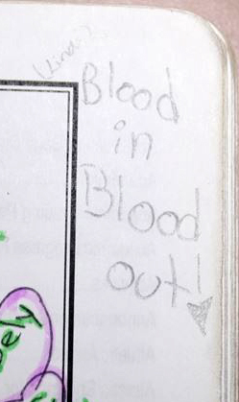
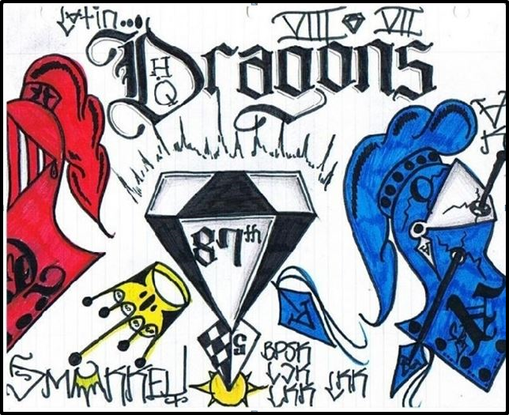
Youth Gang writings, drawings
Notes:
Feel free to insert images of youth gang writings or drawings you have seen in your schools or in areas where youth congregate.
Symbols and Numbers
Symbols and numbers have special significance within the gang culture.
Common symbols of some of the large gangs in the United States include stars (five- and six-pointed), crowns, pitchforks (pointing up or down), three dots in a triangle, and numbers.
These characters do not have the same meaning across the country, and symbolism varies regionally.
Colors
While some gangs have reduced their use of specific colors to avoid identification by law enforcement, many gangs still use one or more colors as a symbol to represent themselves.
The colors can be used in writings, drawings and symbols
Graffiti
Youth who are engaging in graffiti they will often have sketchbooks with graffiti works in progress.

Slide 19
Notes:
Examples of Gang Symbols: Latin Kings, Nortenos
Feel free to insert images gang symbols that are prevalent in your area.

Slide 20
Notes:
Examples of Gang Symbols – Imperial Gangsters, Surenos
Feel free to insert images gang symbols that are prevalent in your area.

Slide 21
Symbols of hate*
* Anti-Defamation League
Notes:
Symbols of Hate

Slide 22
Symbols of hate*
* Anti-Defamation League
Notes:
Symbols of Hate

Slide 23
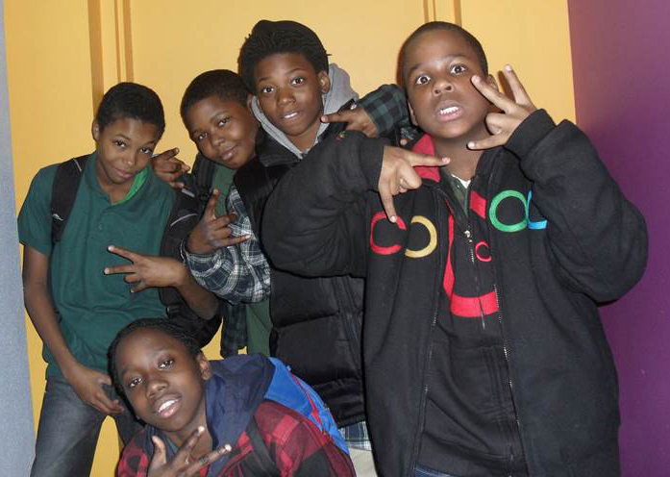
Youth Gang Hand Signs
Notes:
Feel free to insert images of gang hand signs you have seen in your schools or in areas where youth congregate.
Many local homegrown gangs without formal association to a regional/national gang will develop their own hand signs – they are ever changing and you will need to ask an expert.

Slide 24
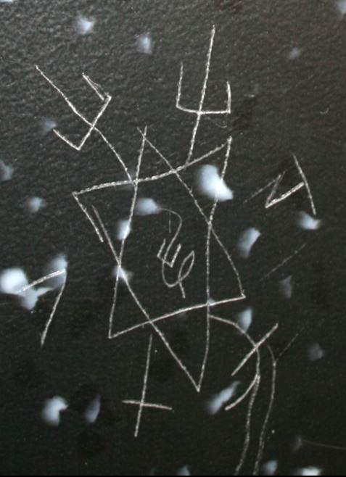
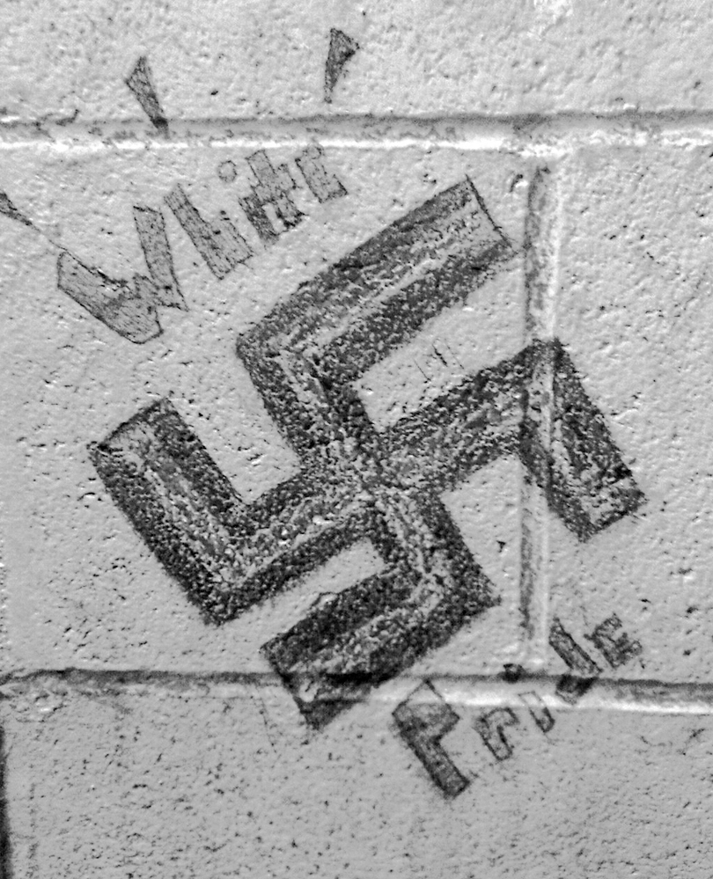
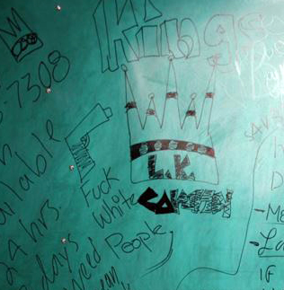
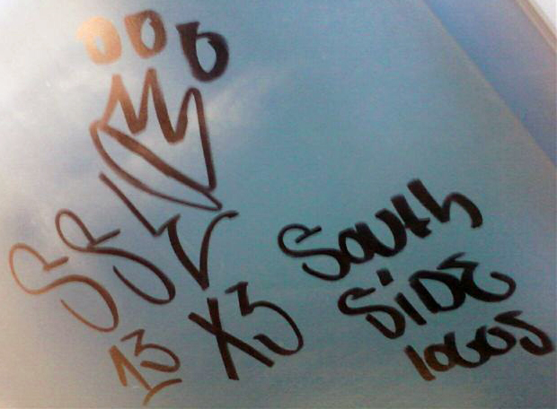
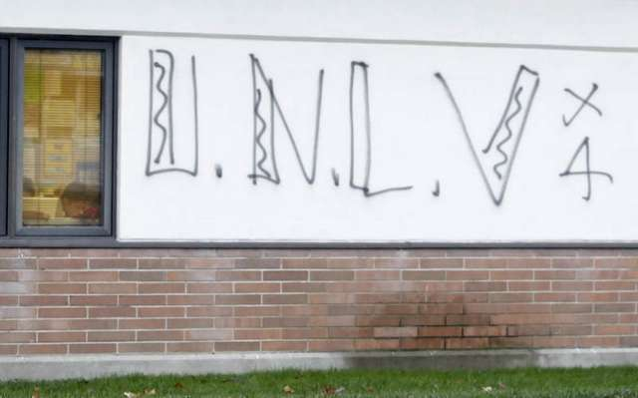
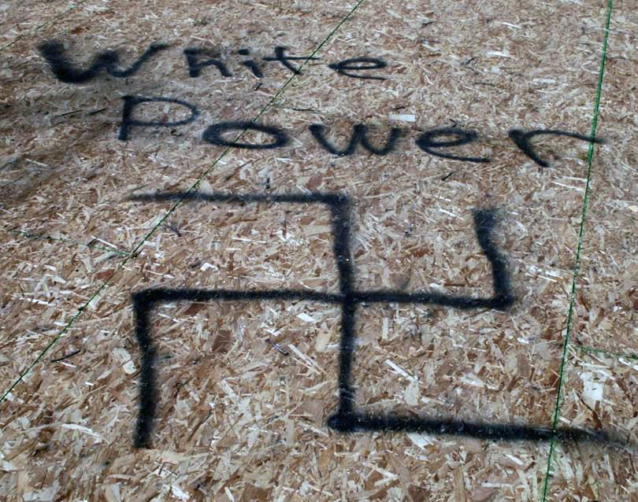
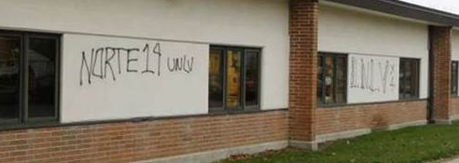
Youth Gang Graffiti in schools/Parks
Notes:
Feel free to insert images of gang graffiti you have seen in your schools or in areas where youth congregate.

Slide 25
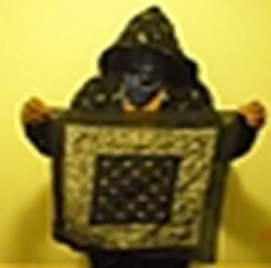
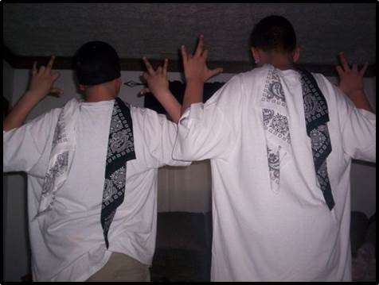
Youth Gang clothing, etc.
Notes:
Feel free to insert images of youth gang clothing, etc. that you have seen in your schools or in areas where youth congregate.

Slide 26
TEACHERS
Develop an Anti-Gang Environment in Your Classroom and School.
If your school does not have a policy regarding gang activity or dress, determine if current school policy will sufficiently cover gang incidents.
If not, assist in getting your school policy updated and parents informed.
Enforce school policies consistently and fairly, and make sure that all students understand.
Obtain the latest information on Gang Awareness.
How Teachers Can Intervene with Gang-Involved Students, 2014, Salt Lake Ares Gang Project, U.S. Bureau of Justice Assistance and The Unit Commission on Criminal and Juvenile Justice.
Notes:
Develop an Anti-Gang Environment in Your Classroom and School.
If your school does not have a policy regarding gang activity or dress, determine if current school policy will sufficiently cover gang incidents.
If not, assist in getting your school policy updated and parents informed.
Enforce school policies consistently and fairly, and make sure that all students understand.
Obtain the Latest Information on Gang Awareness.

Slide 27
TEACHERS
Gangs are constantly changing.
Obtain regular updates from your local law enforcement agency on the type of gang activity in your area.
Learn the newest gangs in the area, their hangouts, graffiti, clothing trends, activities, rivals, etc.
Review your school and school corporation policy
Add your school or school district policy here
How Teachers Can Intervene with Gang-Involved Students, 2014, Salt Lake Ares Gang Project, U.S. Bureau of Justice Assistance and The Unit Commission on Criminal and Juvenile Justice.
Notes:
Gangs are constantly changing.
Obtain regular updates from your local law enforcement agency on the type of gang activity in your area.
Learn the newest gangs in the area, their hangouts, graffiti, clothing trends, activities, rivals, etc.
Share Gang Information with Local Law Enforcement.
Contact your local police department and request that they assign on officer to your school to act as a liaison between the school and the police department. (In many areas, school resource officers are assigned full-time in a school and are available to assist surrounding schools. Find out who that person is).
Meet with the officer on a regular basis and share your concerns.
Add your school or school district policy

Slide 28
TEACHERS
Make Frequent Contact with Parents of High Risk Students.
Parents are often the last to know about their child’s gang involvement.
If you notice sudden changes in attitude, grades, and dress of a student, alert their parents.
Never assume that the parent already knows and just chooses to do nothing about it.
Assign Mentors to Students Who Are Having Difficulty in School.
Many youths are drawn to gangs because it provides them with a support structure and feeling of belonging.
Students who are struggling in school need to feel that they are successful.
A mentor can give a student a feeling of importance – that someone cares about them.
How Teachers Can Intervene with Gang-Involved Students, 2014, Salt Lake Ares Gang Project, U.S. Bureau of Justice Assistance and The Unit Commission on Criminal and Juvenile Justice.
Notes:
Make Frequent Contact with Parents of High Risk Students.
Parents are often the last to know about their child’s gang involvement.
If you notice sudden changes in attitude, grades, and dress of a student, alert their parents.
Never assume that the parent already knows and just chooses to do nothing about it.
Assign Mentors to Students Who Are Having Difficulty in School.
Many youths are drawn to gangs because it provides them with a support structure and feeling of belonging.
Students who are struggling in school need to feel that they are successful.
A mentor can give a student a feeling of importance – that someone cares about them.

Slide 29
TEACHERS
Learn About Community Resources Available in the Area for Students.
Teachers can often steer their students toward positive activities that can reduce their likelihood of becoming gang-involved.
There are also many community resources available for families that are struggling with gang members in their family.
Teach Kids Anti-Violence and Problem Solving Skills.
Many students will turn to gangs to solve problems for them or to provide protection. Teaching your students problem-solving skills and behavioral skills training can reduce the number of violent incidents on campus. Students will also feel more in control and confident of their abilities to “stand alone.” The need for a gang is reduced.
How Teachers Can Intervene with Gang-Involved Students, 2014, Salt Lake Ares Gang Project, U.S. Bureau of Justice Assistance and The Unit Commission on Criminal and Juvenile Justice.
Notes:
Learn About Community Resources Available in the Area for Students.
Teachers can often steer their students toward positive activities that can reduce their likelihood of becoming gang-involved.
There are also many community resources available for families that are struggling with gang members in their family.
Teach Kids Anti-Violence and Problem Solving Skills.
Many students will turn to gangs to solve problems for them or to provide protection. Teaching your students problem-solving skills and behavioral skills training can reduce the number of violent incidents on campus. Students will also feel more in control and confident of their abilities to “stand alone.” The need for a gang is reduced.

Slide 30
TEACHERS
Do Not Glorify Gang Activity, But Do Not Ignore It Either.
Students will often discuss recent gang activity among themselves and may glorify the gang members that are involved.
While such discussions should be discouraged it is helpful for youth to discuss the activity with the teacher serving as a facilitator so that the issue can be dealt with in a realistic manner and used as a learning experience for students.
How Teachers Can Intervene with Gang-Involved Students, 2014, Salt Lake Ares Gang Project, U.S. Bureau of Justice Assistance and The Unit Commission on Criminal and Juvenile Justice.
Notes:
Do Not Glorify Gang Activity, But Do Not Ignore It Either.
Students will often discuss recent gang activity among themselves and may glorify the gang members that are involved.
While such discussions should be discouraged it is helpful for youth to discuss the activity with the teacher serving as a facilitator so that the issue can be dealt with in a realistic manner and used as a learning experience for students.

Slide 31
Gang Identifier Card
Notes:
Every officer, teacher, public official and parent should be provided with the basics of recognizing a gang presence in their community.

Slide 32
Local Resources
Local Law Enforcement
School Resource Officer
School Counselor
School Administrators
Youth Probation
Prosecutor
Indiana State Police
Notes:
Local Resources

Slide 33
Online Resources
Indiana Department of Education
Indiana Model Policy to Address Criminal Gangs and Criminal Gang Activity in Schools: http://www.doe.in.gov/sites/default/files/safety/indiana-model-policy-address-gangs.pdf
Hammond, IN Police Department Gang Suppression Unit
Gang Education: English: http://www.hammondpolice.com/gangsuppressionENG.htm
Spanish: http://www.hammondpolice.com/gangsuppressionSPA.htm
Indiana Department of Health
VIOLENCE PREVENTION RESOURCES for School, Youth and Gang Violence: http://www.in.gov/isdh/25391.htm
Indiana Youth Survey, Indiana University
http://www.inys.indiana.edu/resources
Notes:
ONLINE RESOURCES

Slide 34
Online Resources
National Gang Center
Why Youth Join Gangs Video: https://www.nationalgangcenter.gov/Content/HTML/Why-Youth-Join-Gangs/
Parents’ Guide to Gangs
English:https://www.nationalgangcenter.gov/Content/Documents/Parents-Guide-to-Gangs.pdf
Spanish:https://www.nationalgangcenter.gov/Content/Documents/Gu%C3%ADa-sobre-las-pandillas-para-los-padres.pdf
Frequently Asked Questions About Gangs: https://www.nationalgangcenter.gov/About/FAQ
Office of Justice Programs, National Institute of Justice
Changing Course: Preventing Youth From Joining Gangs (book): http://www.nij.gov/publications/changing-course/pages/welcome.aspx
Notes:
ONLINE RESOURCES

