Slide 1
Welcome Back!! I stood before you 4 years ago and said that UCMS was going to be a world class school. We’ve made progress, but we aren’t there yet! Soon, we’ll be standing in the Hall of Fame!

Slide 2
For your viewing pleasure…
https://www.youtube.com/watch?v=dSoXEtFPTfI&feature=youtu.be

Slide 3
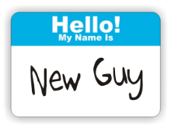
New Staff Introductions:
Amanda Hertel
6th Grade ELA
TBD
Instructional Asst.
Greg Hawkins
7th Grade Social Studies
Mark Olive
Special Education
Mitch Hardy
Band Director
Lindsay Beiser
6th Grade Science

Slide 4
Old Familiar Faces in New Places
Daniel Taylor
8th Grade Social Studies
Emily Snyder
8th Grade ELA
Joel Hofmann
6th Grade Social Studies
h
ISS/Lunch Detention
Moved to Office

Slide 5
Building Updates…
Security Doors on the front
Air Conditioning in the gym
New Roof

Slide 6
WELCOME
Mr. Borowiak
UCCCJSD Superintendent

Slide 7
Evaluations/Walkthroughs (Philosophy)
Evaluation Procedures:
1 Short Observation – at least 10 minutes
1 Long Observation – at least 40 minutes (THIS WILL BE UNANNOUNCED)
All observations will be unannounced.
There will be written feedback on the short and long observations. There will be a post conference for the long observation.
At least one short and one long observation will be completed by January 1st.
Please refer to your RISE Evaluation Model for additional information regarding the evaluation process.
We will be in your rooms a lot, hopefully you will find this is a support to you, validation of your hard work, and an opportunity for Monica and I to know you as a professional educator and our students as learners.
We will be looking for evidence of: data-driven instruction, rigorous instruction (depth of knowledge), differentiation of instruction, authentic assessment, and active student engagement (among other things)
25 % failure rate or higher will be considered as a negative impact on learning
SLOs are coming!

Slide 9
Evidence Domains 1 & 3
Evidence can be requested by the evaluator, but should be gathered by the teacher on his/her own initiative
The evidence collected should be reasonable and meaningful for scoring
The evidence collection process should not be a burden that takes away from quality instruction
Examples of evidence may include (but are not limited to):
Domain 1: Domain 3:
Lesson/Unit Plans Team Planning Documents
Planned Materials/Activities Call-logs/PT Conference Notes
Assessments P/D Materials/Notes
Systems For Record Keeping School Activity/Event Records

Slide 10
Evaluations
Ron is everyone’s primary evaluator (long, shorts, & walkthroughs)
Monica will be a secondary evaluator (shorts & walkthroughs)
Long observations will be unannounced this year

Slide 11
Duty: Duty begins at 7:50 AM for morning assignments (see chart below). Afternoon assignments end at final student dismissal. 7:55 morning/3:05 afternoon
Month:
August
September
October
November
December
January
February
March
April
May
B Wing:
Fields
Dannaker
Hertel
Severance
Hofmann
Hawkins
Hertel
Graham
Beiser
Hawkins
Atrium-Café:
Crumley
Estep
Persinger
Gulley
Olive
Goodwin
Lathery
Taylor
Snyder
Olive

Slide 12
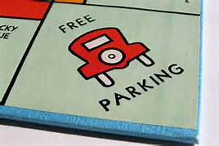
Parking

Slide 13
Faculty Handbook Changes
No real changes:
Dates
Duty

Slide 14
Dress Code
The School Board believes that professional staff members set an example in dress and grooming for their students to follow. A professional staff member who understands this precept and adheres to it enlarges the importance of his/her task, presents an image of dignity, and encourages respect for authority. These factors act in a positive manner towards the maintenance of discipline.
The Board retains the authority to specify the following dress and grooming guidelines for staff that will prevent such matters from having an adverse impact on the educational process. All professional staff members shall, when assigned to corporation duty:
Demonstrate proper hygiene by being physically clean, neat, and well-groomed
Dress in a manner consistent with their professional responsibilities
Dress in a manner that communicates to students a pride in personal appearance
Dress in a manner that does not cause damage to corporation property
Be groomed in such a manner that does not disrupt the educational process nor cause a health or safety hazard
These apply to all employees: administrators, certified teaching staff, and support staff. Bear in mind that some exceptions to these standards are appropriate if in keeping with an employee’s job/function within the corporation. Exceptions will be determined by central office administration. If you have any questions, please discuss with your building administrator.
No flip flops (rubber)
Skirts and/or “skorts” are to be at the top of the knee in length or longer
No cleavage
No shorts
Skin tight materials may be worn on the legs only if covered by a garment that is at least finger-tip length when arms and fingers are extended straight down. Skin tight coverings include, but may not be limited to, leggings, yoga pants, lycra pants, panty hose, etc.).
Capri pants are allowed (they must be mid-knee in length or longer)
Blue jeans are allowed on pay day Fridays only or on special occasion days as determined by the building principal
T-shirts on pay day Fridays only or on special occasion days as determined by the building principal. If they have printing on them it must be school related, i.e. name of the school, name of school team(s), etc.
Sweatshirts are suitable so long as they are neat and clean (i.e. no “ratty” Carharts, etc.)

Slide 15
Subs
Individual staff members ARE NOT to make arrangements for their substitute!
Staff members must give a reason for requiring a substitute. Per the Master Contract those reasons include: personal illness, family illness, personal business, jury duty, and a death in the family. Those are the only reasons to be given to the sub coordinator.
Janet: 765-580-9123 (6:00 AM-6:30 AM) (6:00-7:00 PM)
Leave Request Forms MUST be completed and returned to the sub coordinator within TWO days of returning to school.
Use the black tray by the door for all sub plans & class rosters

Slide 16
Success/Labs
Success/Homeroom/Study Hall – all the same
All 3 grade levels will do it the same way
Extension of grade level curriculum – designed to help all students succeed with grade level content
At the end of each 9 weeks, sheets will be pulled and students will get a new sheet with new skills to focus on
Labs will focus on gaps and holes in student learning

Slide 17
Success on Fridays
Character Education
Clubs
Why Try
Competition Day
More Than Words

Slide 18
MTSS/PBIS/BIPs/Catch Up Café/Etc.
No Catch Up Café
BIPS – managed at each grade level (only IEP BIPs to start)
MTSS Forms (hospital – sooner rather than later)
Academic
Medical
Behavioral
Social/Emotional – mental health
Etc.
Fill out as completely as possible and turn into tray outside Ron/Monica’s office
Forms are on UCMS Forms and Canvas

Slide 19
PBIS
Same basic expectations for all grade levels – Patriot Ppoints/TORN/Dojo/etc..
Personally responsible
Respect
Inclusive
Determined
Efficient
Personally responsible – accountable for one’s own actions
Respect – making good choices
Inclusive – being nice to and including everyone
Determined –demonstrating grit in the face of difficult tasks
Efficient – organized and ready to learn

Slide 20
Referral Process
Level 1 Items
Conference with students
Call Parents
Lunch Detention/Referral
Call Parents on any referral
Level 2, 3, & 4 would by-pass those steps most likely, but still call
Log entries
Note teacher/office in subject line (example)
Paper referrals are placed in tray outside Monica and Ron’s office
White copy
Support
Parent Complaints – email you, call them, follow up with me – cant complain anonymously
Staff Complaints – no anonymous concerns

Slide 21
Academic/Social Probation
Any student earning 3 or more Fs during a 9 weeks grading period will be placed on academic probation for a 9 week grading period. A student that is on academic probation will not be allowed to participate in any extra-curricular activities that are sponsored by the school. This includes athletic participation and/or events, dances, field trips, and convocations.
Any student committing a level 3 or level 4 disciplinary infraction during a 9 weeks grading period will be placed on social probation for a 9 week grading period. A student that is on social probation will not be allowed to participate in any extra-curricular activities that are sponsored by the school. This includes athletic participation and/or events, dances, field trips, and convocations.
Fun Fridays, socials, high school events, etc.

Slide 22
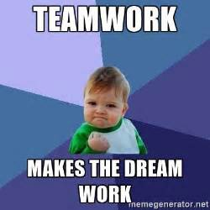
Professional Development
Full faculty meetings will be on Wednesdays. We will meet in an assigned classroom from 3:15 PM – 4:00 PM. These meetings will be used to provide staff professional development opportunities that are research-based and focus on improved instructional strategies or be used as a faculty meeting. Team/Department meetings will be scheduled for the rest of the month and communicated to the teams/departments ahead of time. Please make every effort to leave these predetermined dates from 3:15 PM until 4:00 PM open to avoid conflicts. Any missed meetings will be expected
to be made up with the administration.

Slide 23
Tech support
Brian Rhonemus will be here on Mondays and Thursdays. When a tech is not in the building and you have a concern, problem, or emergency, please call 3306, 3307, or 3308 and one of the techs will address the issue as soon as possible. You can also email ithelpdesk@uc.k12.in.us. The email will provide a faster response as the techs are not always available to answer your phone call, but carry their iPads to receive and respond to emails. Please copy me on all IT emails.

Slide 24
Parent Contacts
Please make sure you have a balance of positive and concerned contacts with our parents (generally speaking this should be done before a referral is written)
Please make sure that when grades are updated please be sure to notify any parents that their student has an F in your class.
NewsLetter - Please submit your weekly contribution based on what is happening in your classroom (and any announcements that you wish to be made on your behalf) to the building secretary by the weekly deadline established.
Please email me if you plan to use social media and/or have a website

Slide 25
Communication
The absolute best way to reach Monica or I is via text. My cell phone number is 765-993-0244. Monica’s is 765-967-2303 . If you need one of us NOW – please text us.
Separate from work
Email – Email is a perfectly acceptable way to reach us and we will respond within 24-48 hours, but if your situation is more urgent – please text us.
Wait before you send an email
Reply All
Emailing outside of the building – copy me
Call – You are always welcome to reach us at our extensions or the numbers above.
Discussion – Anita Dannaker

Slide 26
Social Media
https://www.facebook.com/PatriotsOfUCMS/
@UCMS_Patriots
@UCMS_Patriots

Slide 27
Technology
1 to 1 (6th - 8th grade)
Laptops/Carts/Not taking home
Sheet to track damage
Deb – consequences/loaners
Restart laptops on Friday
Field Trip Request Forms (Staff Resources)
Canvas (P/D course, School wide page, eLearning)
Testing on laptops this year
Shut Machines Down
Color printing -48 hours notice as IT ticket (time/date/printer)
All parents signed the Internet user agreement for their students
Web content filter (access to blocked sites)
Student passwords, we need to recreate the list in forms
One Drive – works like google, can be accessed from our webpage

Slide 28
Power School
Referrals = log entries
Attendance through Power School
8:20 AM – must be entered
Grades
Weighted grades, make sure assignments match the weight given

Slide 29
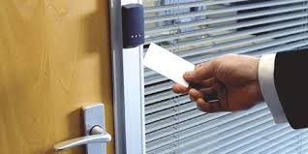
Door Access
All teachers can use their key fob/badges to access all doors at the middle school except the kitchen (door #10) and the boiler room (door #11). There is access at the back door now as well.

Slide 30
Assessment Schedule
NWEA
August 19th-September 6th-NWEA-Round 1
December 2nd-December 20th-NWEA-Round 2
March 2nd-March 20th-NWEA Round 3
All 3 tests, All 3 windows
Science and/or SS help out?
ILEARN
April 20th – May 15th

Slide 31
First Day of School – 6th Grade
11:26-11:56 AM Lunch
1:00-2:00 PM Grade Level Meeting in Cafeteria
Be fair to Mitch and Debbie and their time & communicate with Arika, Mark, and the office
Class schedules are up to each grade level

Slide 32
First Day of School – 7th Grade
9:28 – 10:28 AM Grade level meeting in Cafeteria
10:32-11:02 AM Lunch
Be fair to Mitch and Debbie and their time & communicate with Arika, Mark, and the office
Class schedules are up to each grade level

Slide 33
First Day of School – 8th Grade
8:28-9:28 AM Grade Level Meeting in Cafeteria
12:20-12:50 PM Lunch
Be fair to Mitch, Debbie, Blake and their time
Class schedules are up to each grade level & communicate with Arika, Mark, and the office

Slide 34
Other Important Dates
UCMS Events Calendar
Dates on calendars
Challenge Day 8/21
Volunteer sign up
??

Slide 35
Parent Night
August 6th from 7-8 PM
There will be no presentation in the gym. Monica and I will give parents a flyer as they enter. This will give them more time to visit with all of you. Lisa will be here to help print schedules if need be. The expectation will be for the teachers to be at their door to greet families. Families can enter your room, drop off supplies, ask you questions, etc. Keeping you in the hallway encourages families to interact with you, but prevents anyone from monopolizing your time and/or engaging in a more in depth conversation that would be more appropriate at another time. If you wish to have a handout or brochure of some kind to give out you may do that as well. Monica or I will come on the PA at 8 PM to signal the end of the evening.

Slide 36
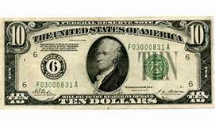
Workroom Fund
$10 to Lisa – this covers sympathy cards and flowers, lunchroom supplies, coffee, etc.

Slide 37
Home Room
W-F Handbook Information
Will meet with this group for the first part of August in homeroom before transitioning to success
Bully Education for students and staff
Gang Education for students and staff
Build relationship with these students
This will be your study hall group
We will use home room after Success Period Begins to handle advisory types of things, surveys, etc.
Clubs (everyone – email Monica) (first three Fridays of the month) & Competition Day (last Friday of the month) – stay tuned for a schedule of dates, will begin in September
Success Period will ‘officially’ begin August 19th and adjusted after NWEA Round 1
Handbook/Drug Testing Sign-Offs

Slide 38
School Safety
School Safety Team (Daniel, Ron, 7th grade teacher?, Bryanne, Lori, Lisa, Amy, & Monica)
Will meet quarterly to discuss school safety issues
Ron is out September 30th – October 1st for School Safety Conference
Daniel & Monica are out ???
Visibility & Supervision – report all JDLRs
Safety Drills (Tornado, Fire, & Lockdown during the first week) – convocation on Friday – normal schedule… maybe leave a few minutes early from 7th period?
Fire Drills are over the P/A – not the alarm system
Orange Signs
DCS Reporting Law Change (documentation form is in UCMS forms)
Classroom safety
Neat & orderly
Nothing stacked on top of shelves
Clear walkways
Anything you want discussed?

Slide 39
Student Discipline
Teachers will handle all tardy disciplinary notices except first period – notify Lisa of any tardies to first period that don’t arrive with a pass
Lunch Detention/ISS – Bev
Friday School 3:15 – 5:00 PM
Monica’s Role (come into your room – provide support in the classroom)
Incentive (Success & PBIS) – year end activities
Earn a D- or better in all classes, including citizenship –
No in-school or out-of-school suspensions
No more 3 tardies to any class per 9 weeks
No more than 3 disciplinary referrals per 9 weeks (it cannot be a level 3 or 4 offense)
No more than 3 full day absences per 9 weeks except for doctor excused absences
No F in citizenship
Success/Behavior/ILEARN Attendance/Year End Activities

Slide 40
Bus Lineup
Copies of these are on the table – please remember to assist students (especially our 6th graders) as they navigate this process
*3:05 Bell – we must be more diligent!

Slide 41
Accountability
ESSA
Attendance, Science
School Grade Cards

Slide 42
Housekeeping
Centerstone
Water Bottles (lid and cannot spill)
Committees
Leadership Teams: Amy, Susan, & Shannon
School Improvement: Paige, Shannon, Tonia, Susan, Amy, Monica, Julene, & Ron
Crisis Team: Julene, Mark, Arika, Ron, Paige, Sharon, Donna, Sharon, Shannon, Monica, Joel, Bev, & new aide
Safety Team: Ron, Lori (Tice), Lisa, Monica, Daniel, Bryanne, & we need a 7th grade teacher?
Social Committee: Tonia, Julene, & Anita
Grade Level Responsibilities
Student of the month, special schedules, liaison to the office, citizenship, parent contacts, MTSS/BIPs Coordinator
Go Formative/My Homework/Others?
Permission Slips
No Tape on the Floor – 24 hours
No passes to the office during study hall to use phones

Slide 43
Setting the stage…

Slide 44
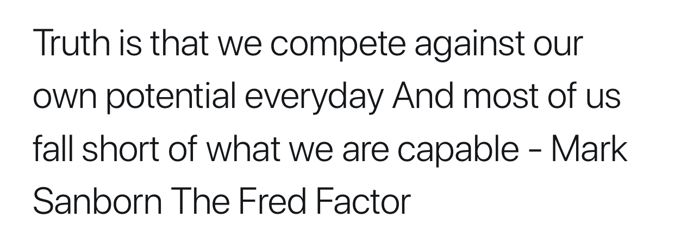
The “Fred” Factor
3600 seconds in an hour
We are here 8:00 AM – 3:00 PM (7 hours)
25,200 seconds in a school day
4,536,000 seconds in 180 school days
How will you make the most of these moments and maximize your potential to impact our students and make UCMS the best school in the world?

